Slide 1
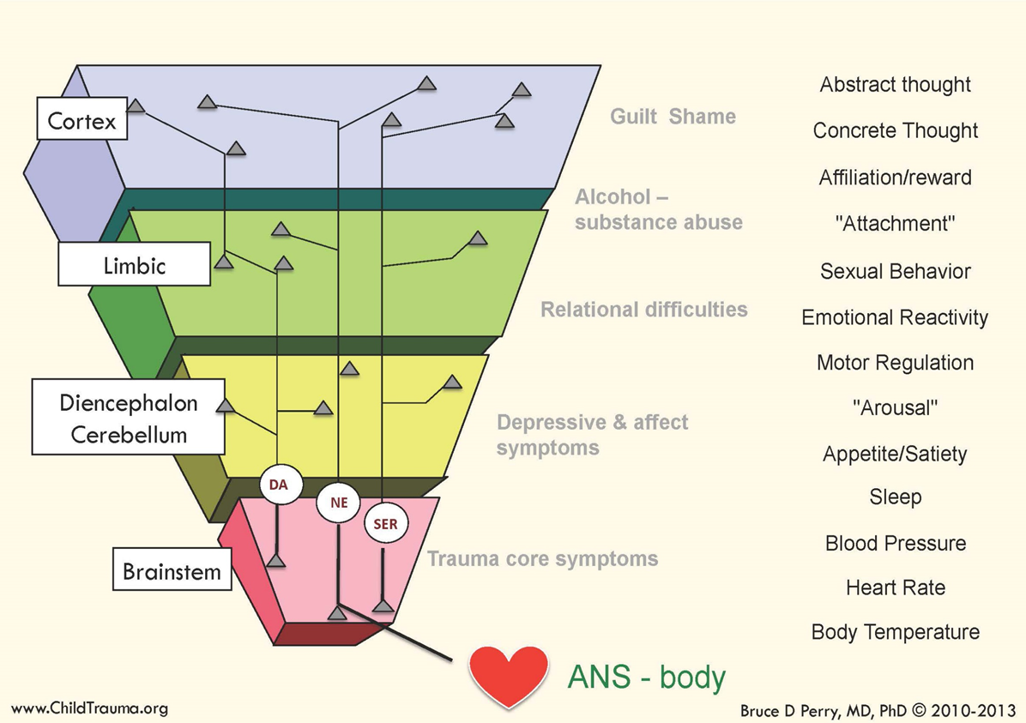
Dr. Bruce Perry
Executive functioning is in cortex. Not developed until 30.
All information comes into the brain from the bottom up through the stress response.
The chemicals that support functioning start in the brain stem and go to the body through the Parasynaptic and
Sympatric Nervous system.

Slide 2
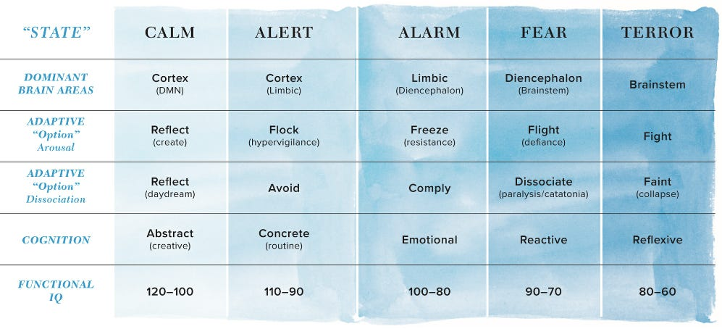
Function and States

Slide 3
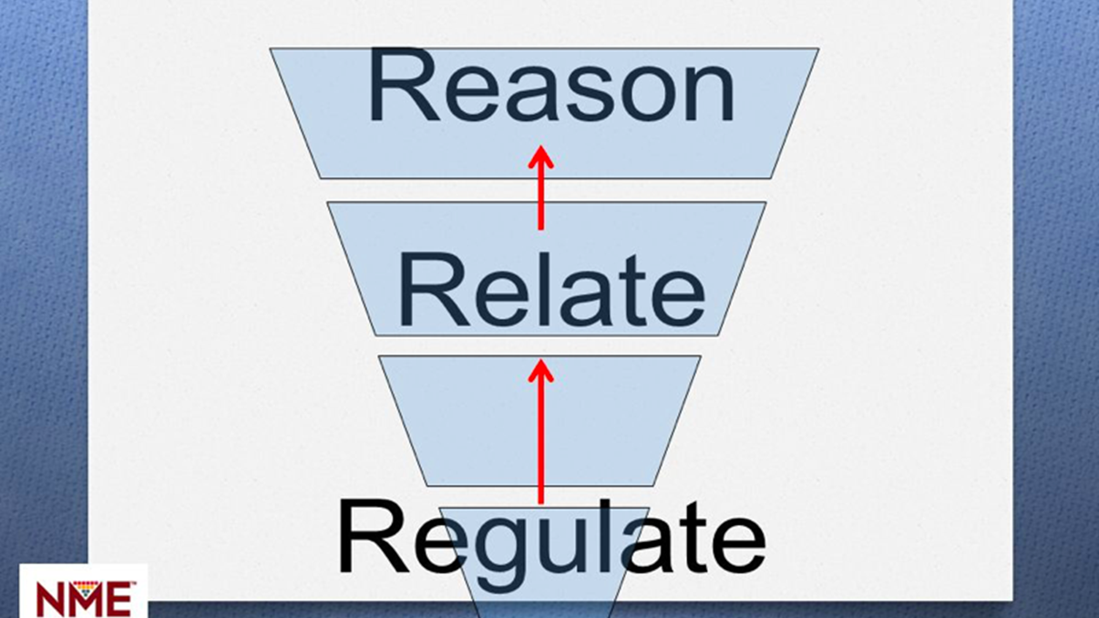
Notes:
Have to take care of needs in order. Can't reason with out relationship, and can't have a relationship without regulation.
A student who is

Slide 4
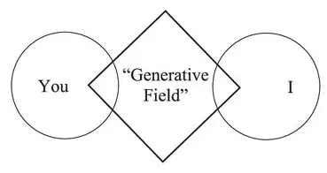
Generative Social Feilds
Dr. Mette Boell and Dr. Peter Senge

